Slide 1
Cyanide – the deadly gas & salt
Joel Dickson & Chris Kliem

Slide 2
Research Question
Does an average everyday exposure of cyanide cause enough of a toxicity level to create adverse effects?

Slide 3
What is the toxin and what does it naturally occur in
The toxin is Cyanide. The chemical structure is: CN⁻
In nature it is commonly found in seeds (apples, peaches, apricots, etc).
Naturally produced by some bacteria, fungi, algae, and plants - often used as a defensive measure

Slide 4
Natural occurrences and exposure types
Naturally found in seeds and produced by some bacteria, fungi, algae, and plants - often used as a defensive.
Exposure is often thru cigarette smoke and burning of plastics
In the manufacturing world; it is used to make paper, plastics, textiles, electroplating, metal cleaning, separating ore, fumigation
Historically was used by Nazi Germany in the death camps and possibly in the Iran-Iraq war in the 1980’s

Slide 5
Mechanism of action
Hydrogen cyanide (gas), potassium cyanide (salt), sodium cyanide (salt) are the most lethal forms
Depends on the amount and length of time of exposure
Breathing hydrogen cyanide gas is the most lethal but so is swallowing the salt forms
Cyanide prevents the cells from using oxygen so they die. Most lethal to the heart and brain as these organs use the most amount of oxygen.
In large doses, binds with iron in cytochrome a₃, preventing electron transport in the cytochrome. This stops oxidative phosphorylation and ATP production. As a result, intracellular oxygen utilization ceases. Cells are then forced into anaerobic metabolism, creating lactic acid and leading to acid-base imbalances and metabolic acidosis.

Slide 6
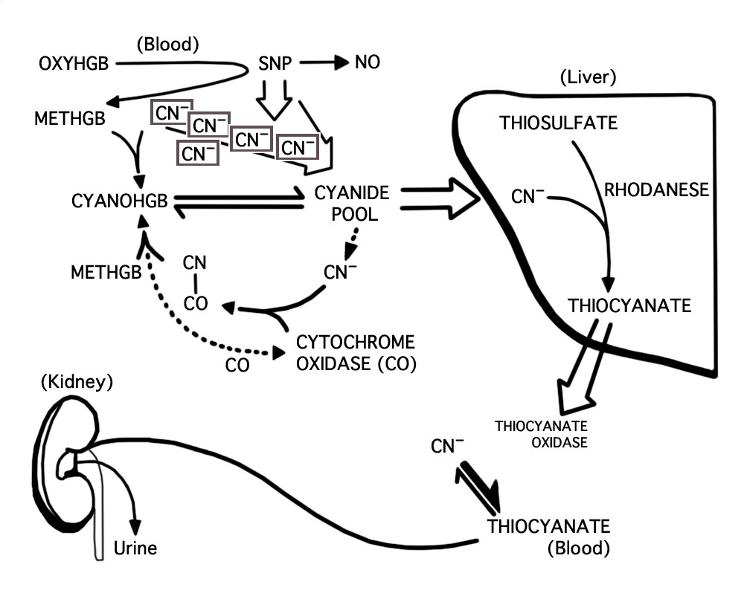
Pathway

Slide 7
Dose Response
Probability that someone weighing 160 lbs who ingests 0.3632 grams potassium cyanide will die within three days is 50 %
If they ingest 0.55 grams, the probability is over 90 %.
A teaspoon = 5 grams and a tablespoon = 15 grams.
Death due to cyanide poisoning will occur in 2-6 hours.

Slide 8
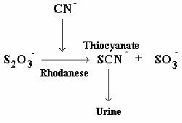
Metabolism
Plasma half time is 20 minutes to an hour
In small doses, can be metabolized into thiocyanate with the assistance of the rhodanese. Thiocyanate is then excreted in urine. A small amount of cyanide can also be converted to carbon dioxide which leaves the body through exhalation.
Some cyanide can react with hydroxycobalamin to form vitamin B₁₂.
Most cyanide leaves the body within one day.

Slide 9
Risk of exposure
Normal levels in blood plasma can be from 0-14 ug/dL
Cyanide content in unpolluted air is 0.160-0.166 ppm
Half-life in the air is 1-5 years
Cigarette smoke is 10-400 ug/dL for mainstream smoke
Most public tap water is under 0.2mg/L
In reference 1mg/L=1,000ug/dL

Slide 10
Care management
Antidotes are hydroxocobalamin (Cyanokit) and sodium thiosulfate and sodium nitrite (Nithiodote) given intravenously
With acute poisoning from hydrogen cyanide (HCN) gas or soluble salts, the principal concerns are hemodynamic instability and cerebral edema. Continuous cardiac monitoring, respiratory and cardiovascular support, and frequent neurologic evaluation of these patients is required.
Acute poisoning from cyanogens (nitriles) or poorly soluble salts may not manifest or become life-threatening for several hours after exposure. Requires a 24-hour observation period
Oxygenation should be optimized and continuous cardiac monitoring provided. Serum lactate concentrations, chemistries, and arterial or venous blood gases should be monitored.
Patients should be reevaluated 7-10 days after discharge from the hospital. Delayed onset of Parkinson-like syndrome or neuropsychiatric sequelae may be noted on followup.

Slide 11
Death penalty uses
Gas Chamber - potassium cyanide or sodium cyanide crystals are added to a hydrochloric acid producing hydrogen cyanide gas
Entire process takes 5-15 minutes
Body is very difficult to safely dispose of
A few states use this method as a secondary method only

Slide 12
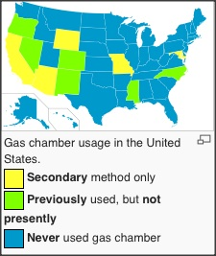
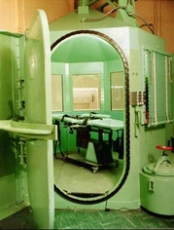
Death Penalty

Slide 13
Summation
For example with apple seeds
These average around 0.6mg hydrogen cyanide (HCN) per gram of dry seeds. Since the lethal dose is about 50mg, you will need around 85 grams of dry seeds. This is around half a cup.
This equals about 18+ apple cores in one sitting

Slide 14
Sources
"ChemSee." ChemNote: Cyanide Poisoning. N.p., n.d. Web. 22 Nov. 2014. <http://chemsee.com/poison-detection/poison-detection-resources/cyanide-poisoning/>.
"Cyanide Toxicity Treatment & Management." Cyanide Toxicity Treatment & Management. N.p., n.d. Web. 22 Nov. 2014. <http://emedicine.medscape.com/article/814287-treatment>.
"Facts About Cyanide." CDC. N.p., n.d. Web. 22 Nov. 2014. <http://www.bt.cdc.gov/agent/cyanide/basics/facts.asp>.
"Methods of Execution." Methods of Execution. N.p., n.d. Web. 22 Nov. 2014. <http://www.prodeathpenalty.com/methods.htm>.
"The Facts About Cyanides." The Facts About Cyanides. N.p., n.d. Web. 22 Nov. 2014. <http://www.health.ny.gov/environmental/emergency/chemical_terrorism/cyanide_tech.htm>.
Toxguide TM for Cyanide CN CAS# 74-90-8 (2006): 1-2. Web. 28 Oct. 2014. <http://www.atsdr.cdc.gov/toxguides/toxguide-8.pdf>.

Slide 15

Review Video

